Slide 1
DATA SCIENCE PROJECT
Group 79
Nabila Pindya - s3071219
Nisa Azmi D - s3058018

Slide 2
Project Description
Project
01
Business Intelligence
Primary Topic
02
DPV
Dataset
03
Sakila DB

Slide 3
Rental Business Process
Customer visits the store, Picks a DVD
Customer paid the rent
DVD took out of inventory by the staff member
Customer returns home and enjoys DVD
Customer returns to store with DVD
DVD returned to the staff member

Slide 4
Business Question
Balance Scorecard Perspective
Revenue Perspective
Customer Perspective
How to optimize pricing strategies for DVD rental business to maximize profitability?
What are the customer demographics and preferences that are most likely to rent a higher number of DVDs and have a higher likelihood of returning as repeat customers?
A
B
C
D
Internal Process Perspective
Learning and Growth Perspective
What are the internal processes and factors that have the most significant impact on the efficiency of DVD inventory?
What is the impact of staff experience levels on rental return rates?

Slide 5
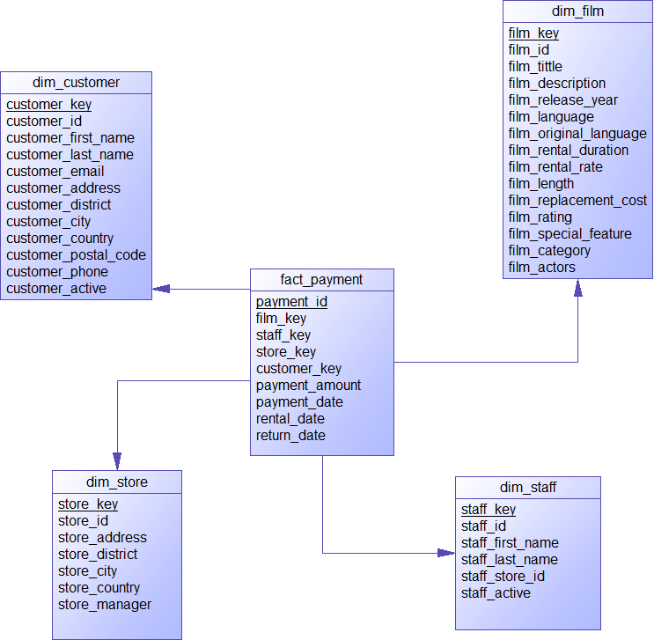
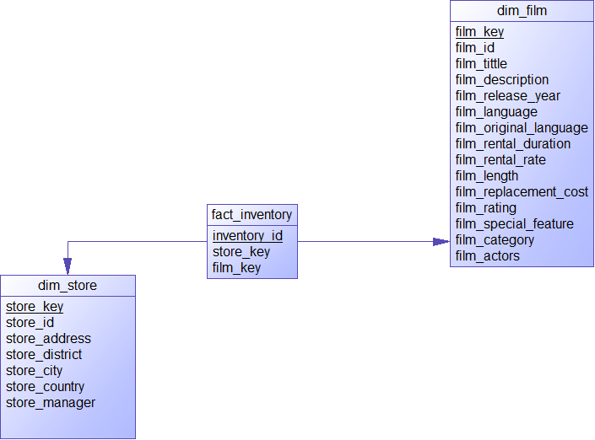
Star Schema
Insert the title of your subtitle Here

Slide 6
ETL
Connect to the source database: Establish a connection to the source database MySQL using MySQL Connector.
Extract data: Use SQL queries to extract data from the source database tables. Store the extracted data frame Pandas data frame.
Clean and transform data: Clean and change the extracted data using Pandas functions and methods.
Create tables in the data warehouse as defined in the star schema
Load data into the data warehouse: Connect to the PostgreSQL data warehouse using a Python library psycopg2. Then load data to the data warehouse in bronto.ewi.utwente.nl

Slide 7
Visualization
Created using Python

Slide 8
Financial Perspective
Revenue
Revenue per customer
Rental price per movie
Revenue per category film
Popularity of films
What is the most feature concerned by the customer?

Slide 9
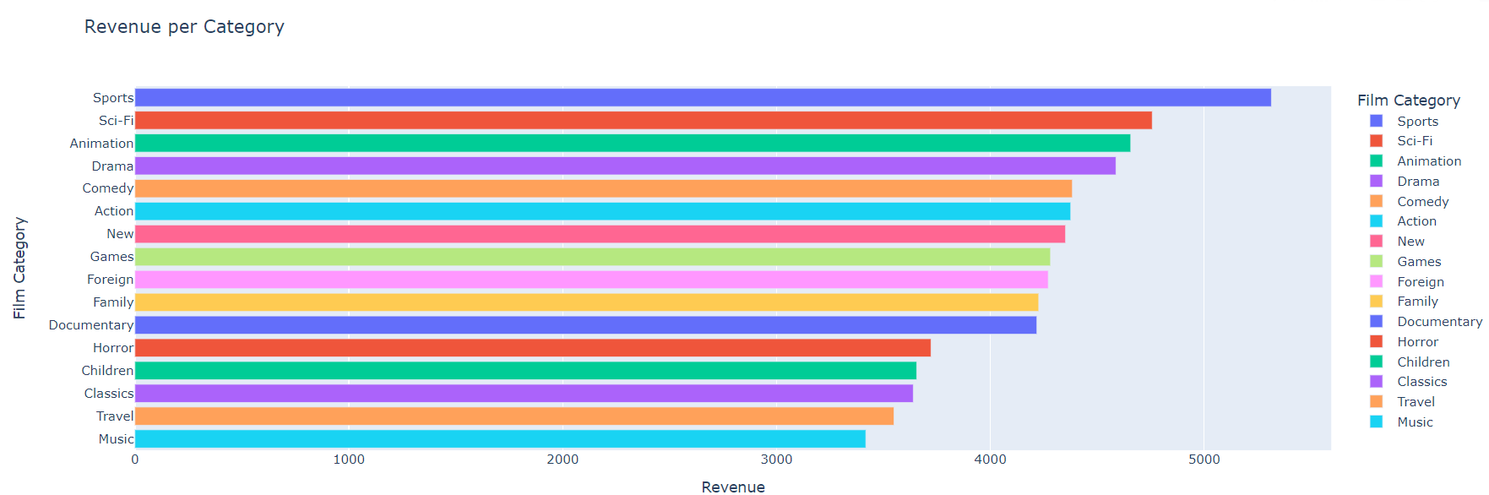
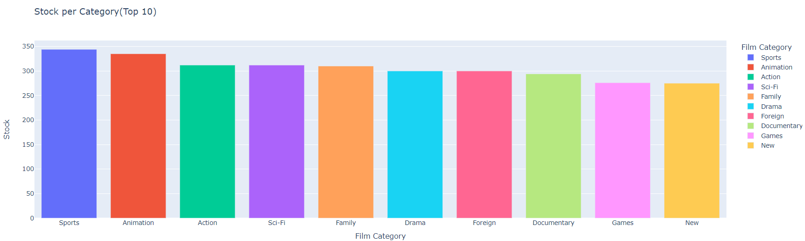

Slide 10
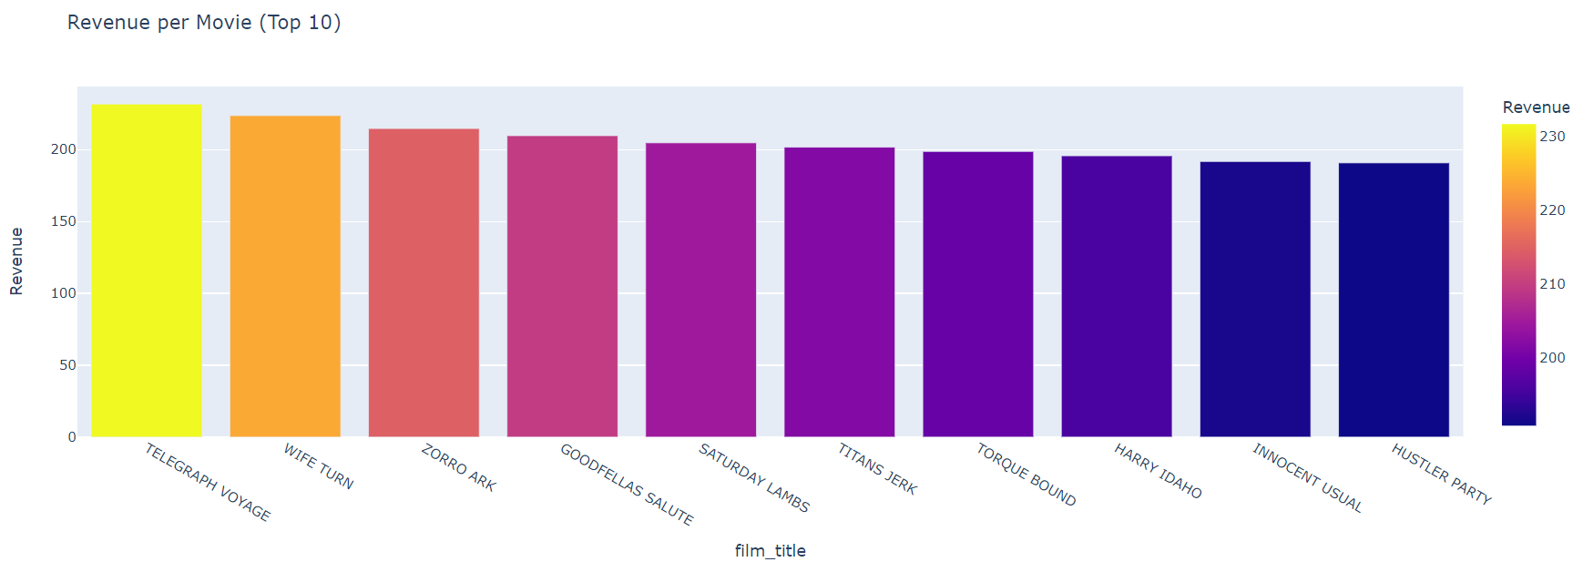
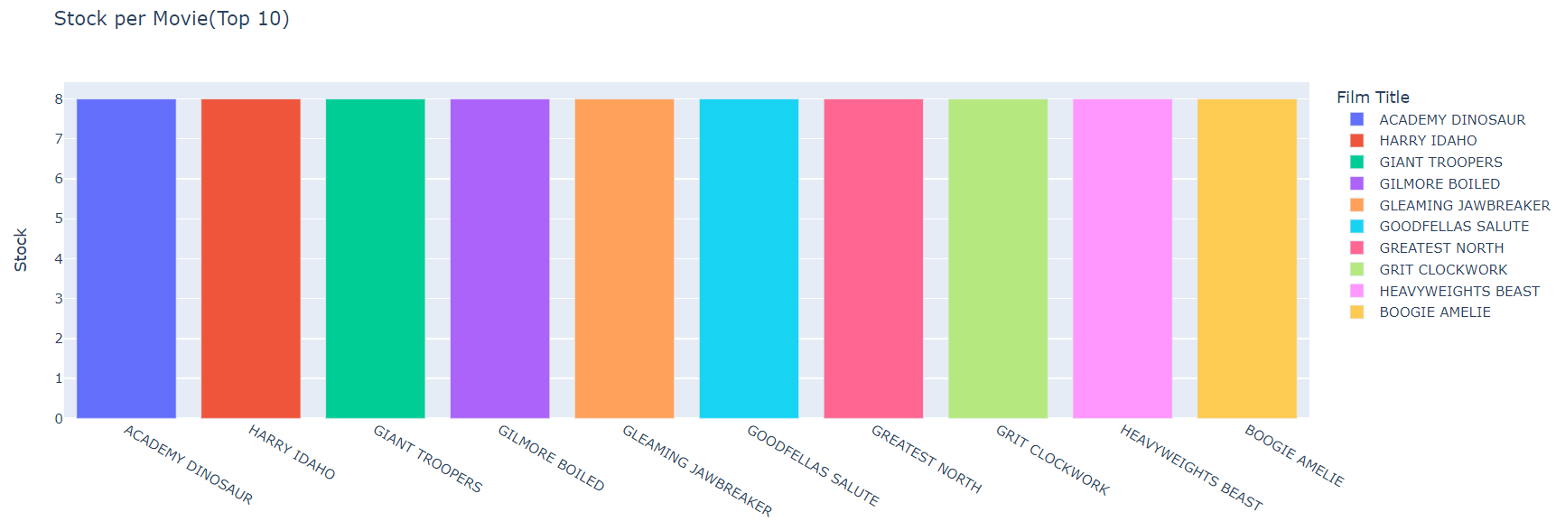

Slide 11
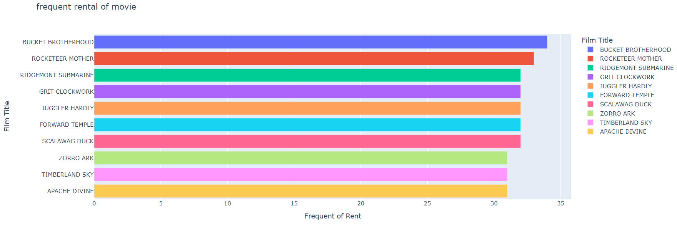

Slide 12
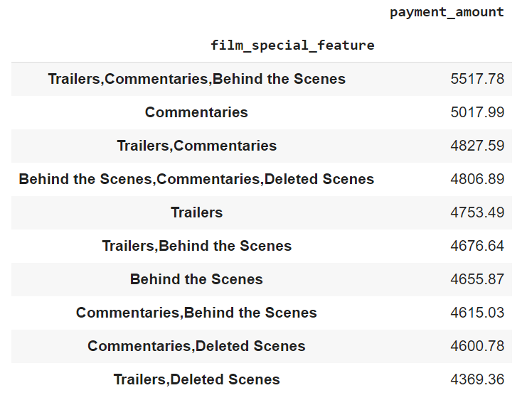

Slide 13
Customer Perspective
Most valued Customer
RFM (Recency, Frequency, Monetary) Analysis

Slide 14
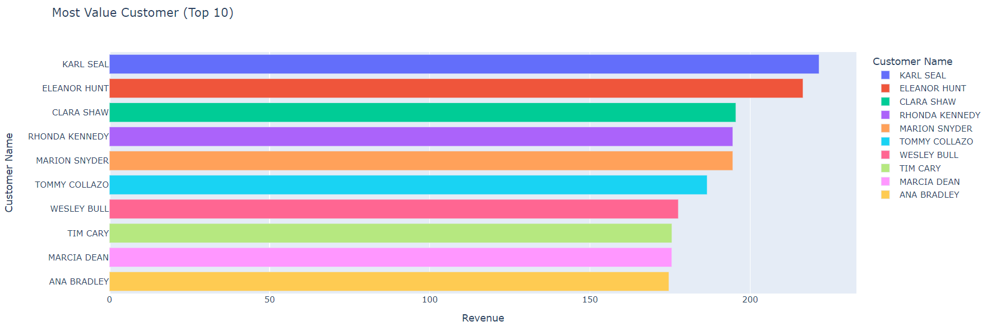

Slide 15
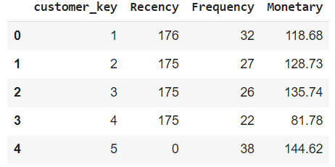
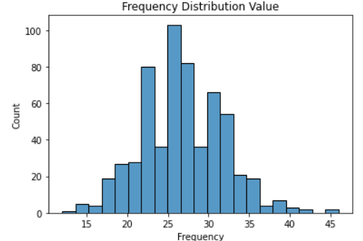
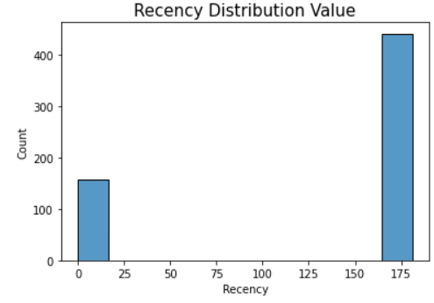
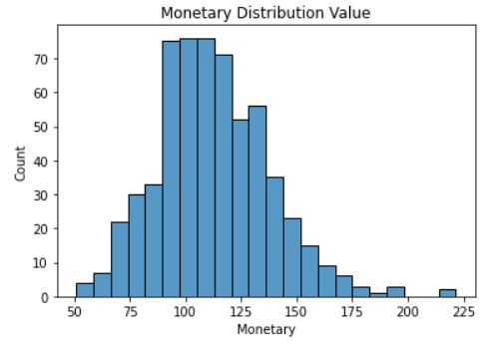
RFM
(Recency, Frequency, Monetary)
Analysis

Slide 16
RFM (Recency, Frequency, and Monetary) Analysis

Slide 17
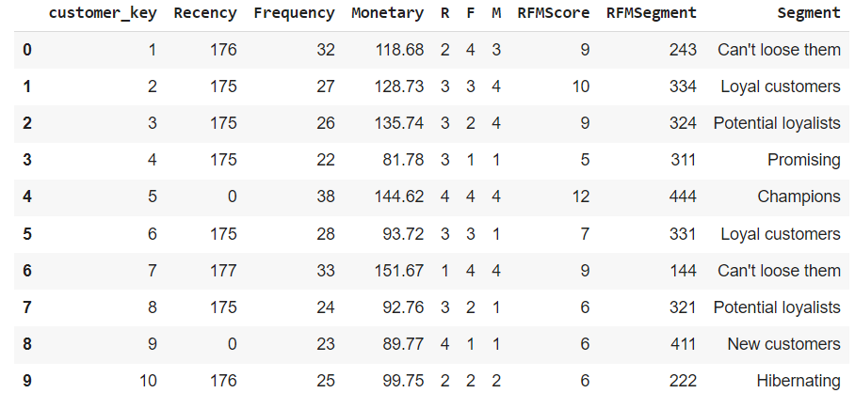
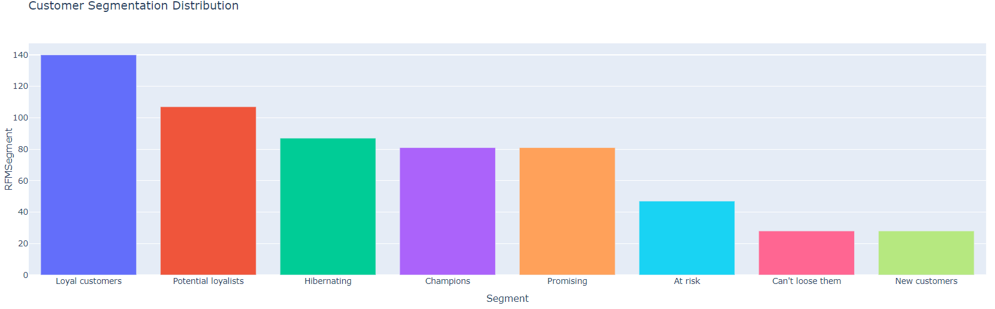

Slide 18
Hibernating: Rebranding value. Offer relevant products and give good offers
Champions: Give Loyalty Rewards or give chance for them to try a new product
Loyal Customer: Sell higher value products and ask for their review to know more about their experience
At Risk: Send an email blast to reconnect to them and give a product recommendation
Potential Royalist: Give product recommendations and loyalty rewards to engage them
Can’t Lose Them: Give special offers to them to make them feel valuable again
Promising: Make brand awareness
New Customer: Start building relationships by providing a good experience
R
E
C
O
M
M
E
N
D
A
T
I
O
N

Slide 19
Internal Process Perspective
Number of Inventory per store
Total Revenue Per store
Average duration rent per film compared to actual duration
Duration of rent per film compare to film length
Average duration rent per category film

Slide 20
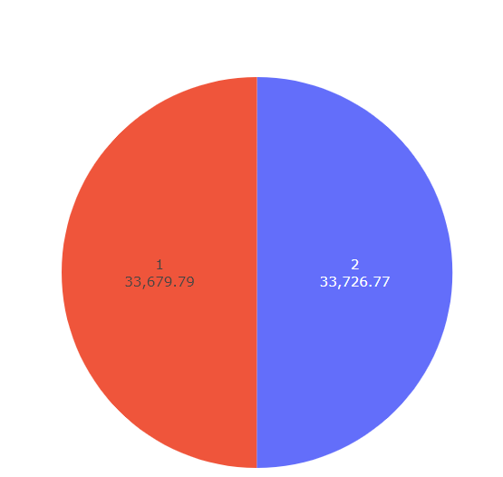
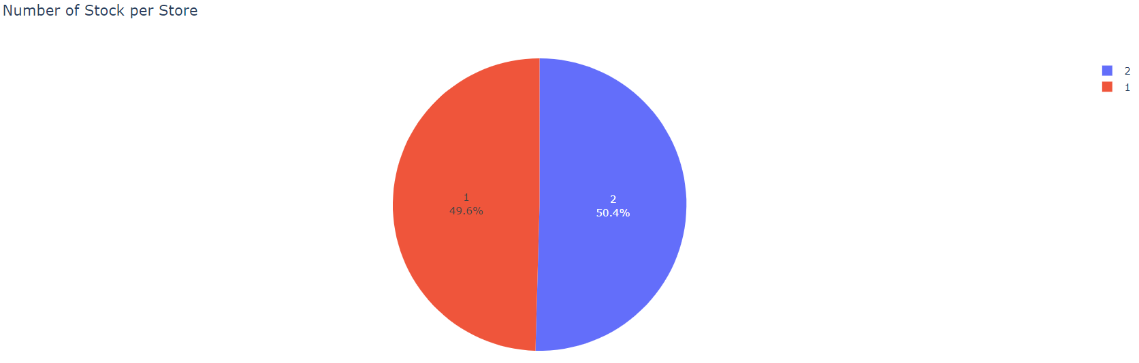
Number Stock Per Store
Revenue Per Store

Slide 21

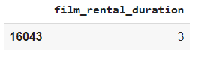
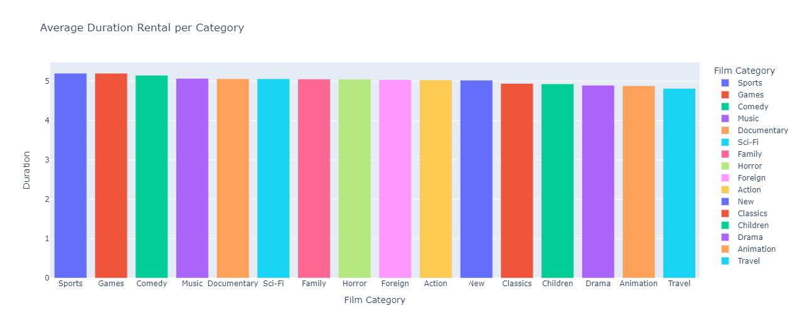
Minimal Rental Duration : 3 days Maximum Rental Duration : 7 days

Slide 22
Innovation & Growth Perspective
Staff experience levels: A metric that measures the experience of employees.
Rental return rates: A metric that measures the percentage of DVDs returned on time by customers.

Slide 23
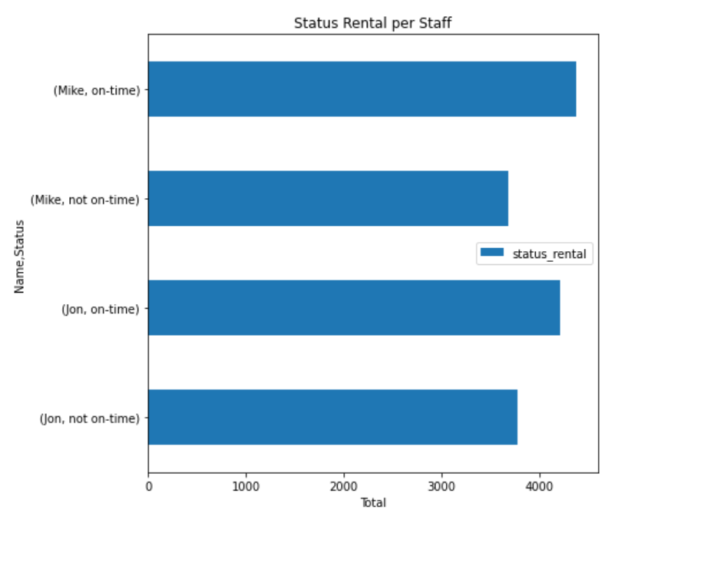
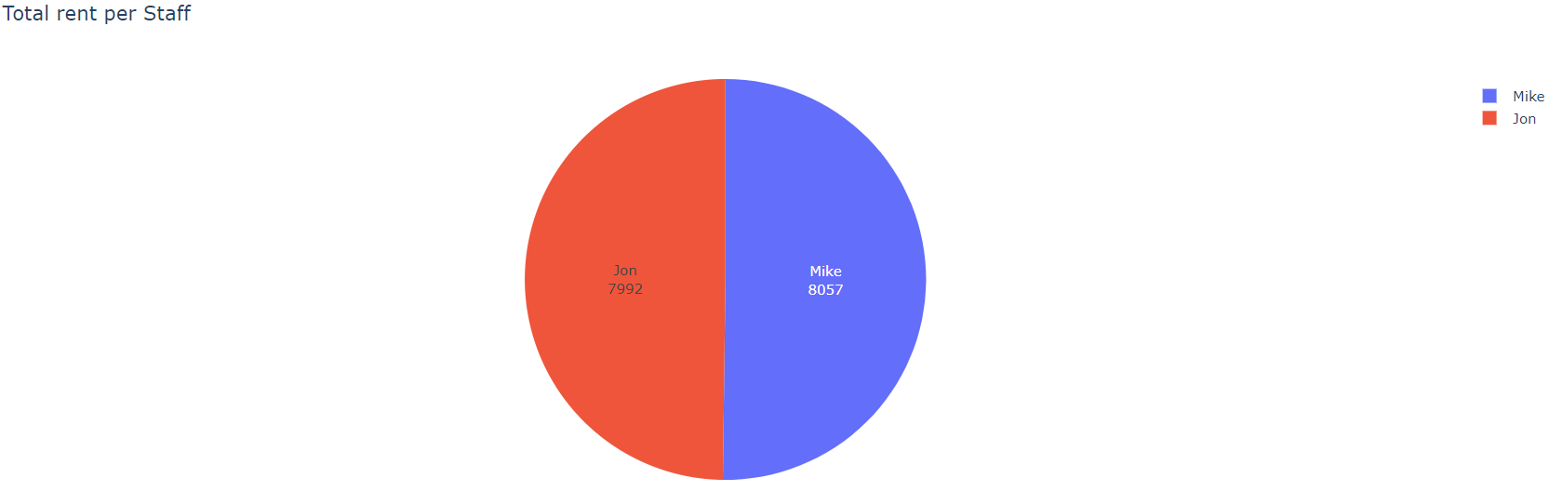
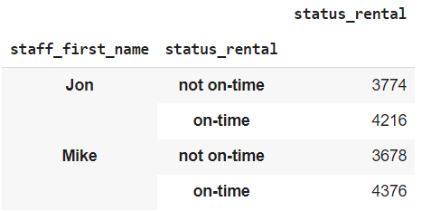

Slide 24
Conclusion
The Pricing strategy can be adjusted to maximize the profit
Minimum rental duration can be changed to 4 days since the average rental duration is between 3 – 5 days
Do the recommendation to maintain good relations with customers

Slide 25
Thank you
Insert the title of your subtitle Here

